Slide 1
How to Run a Database in Production on Kubernetes Kubernetes Master Class Series
#Rancherk8s
February 11, 2020

Slide 2
Rancher Master Class Series:
45 minutes - 1 Hour
Questions are always welcome
Use the questions tab to write your questions
We may respond to all, so mark your question as private if needed.
#Rancherk8s

Slide 3
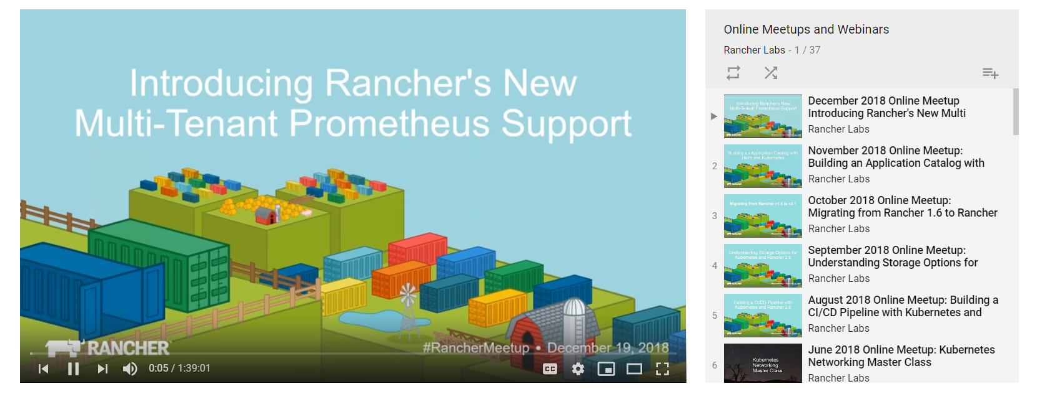
This session is being recorded!
http://youtube.com/c/rancher
#Rancherk8s

Slide 4
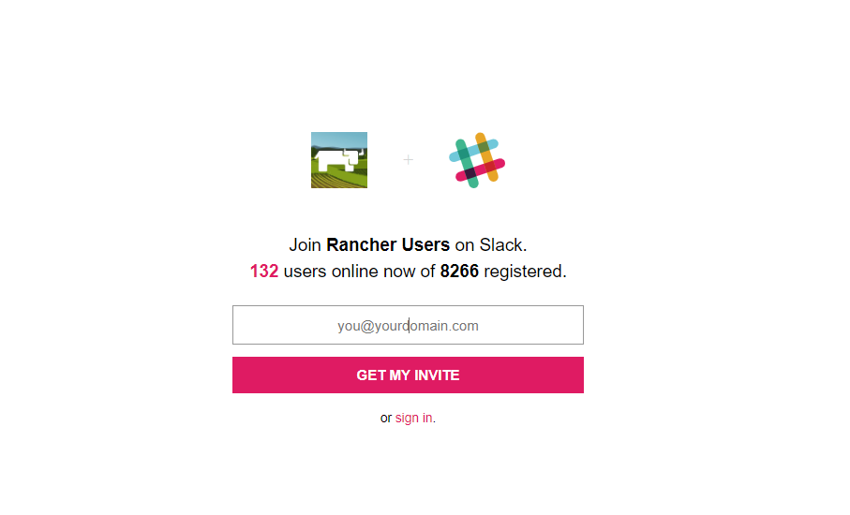
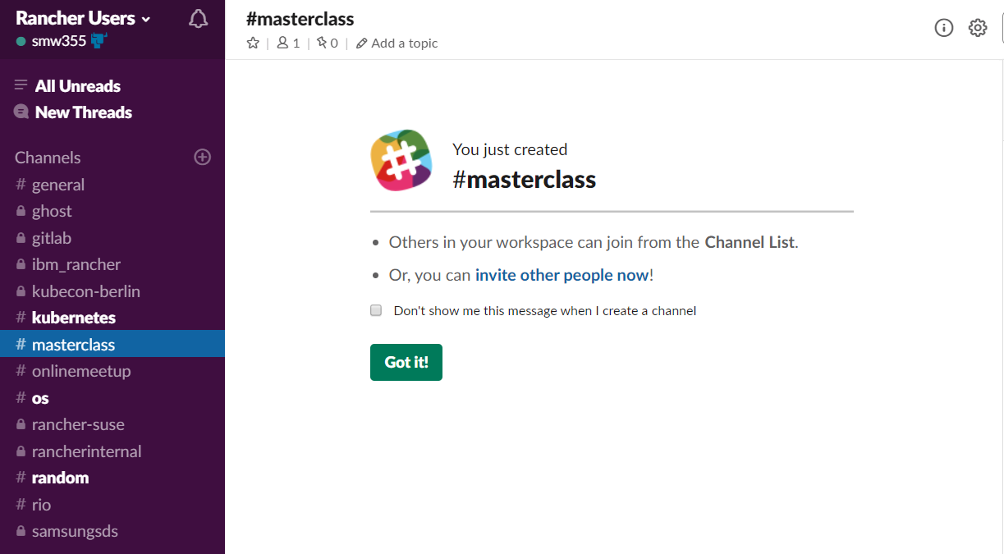
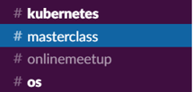
Join the conversation on Slack
http://slack.rancher.io
#masterclass
#RancherK8s

Slide 5
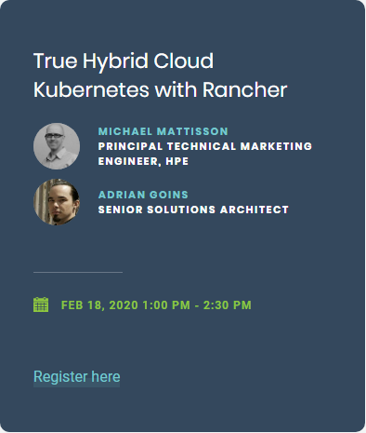
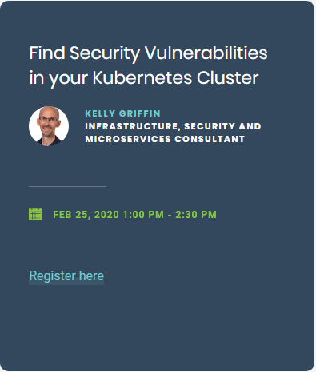

Slide 6
Who am I
Matthew Mattox
Support Engineer
https://github.com/mattmattox
#RancherK8s

Slide 7
Agenda
Requirements and Design
Setup / Configuration
Common Ops tasks and scenarios
Recommendations
Note: all examples are based on Kubernetes cluster built using RKE v1.0.4 but can be used on any Kubernetes distribution with minor adjustments.
#RancherK8s

Slide 8
Requirements and Design
What level of availability is required?
Does your app need 7 nines of uptime?
What does the workload look like?
Does it do a lot of batch processing?
What is the Data Integrity requirement?
Is some data loss ok?
What is the Data consistency requirement?
Does your data always need to be 100% in sync all the time?
#RancherK8s

Slide 9
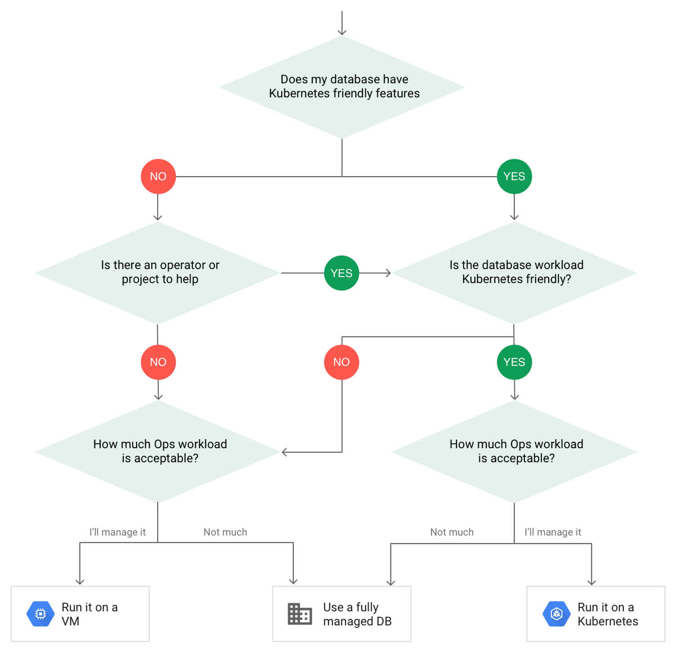
#RancherK8s

Slide 10
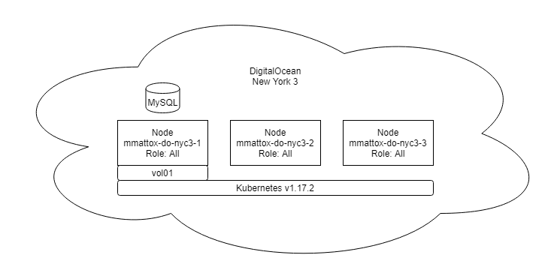
Setup / Configuration
Standalone MySQL with HA storage
https://github.com/mattmattox/Kubernetes-Master-Class-Databases/tree/master/single-node-mysql
#RancherK8s

Slide 11
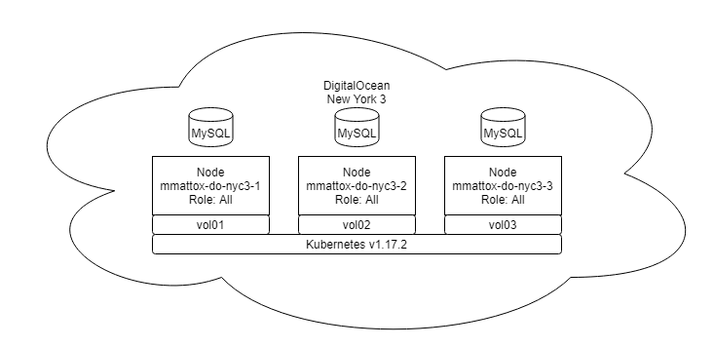
Setup / Configuration
MariaDB Galera Cluster
https://github.com/mattmattox/Kubernetes-Master-Class-Databases/tree/master/mariadb-galera
#RancherK8s

Slide 12
Recommendations
Have a test environment often
Break your (test) environment often
Make it easy for yourself, use labels/naming convention (for example, region or availability zone)
Get comfortable with debug and recovery processes
Document your environment (Server names, locations, and access)
Setup database backups cronjobs
Test your database backups and document restore process
#RancherK8s

Slide 13
Resources
https://slack.rancher.io
https://forums.rancher.com
https://docs.rancher.com
https://github.com/mattmattox/Kubernetes-Master-Class-Databases
https://hub.helm.sh/charts/bitnami/mariadb-galera
#RancherK8s

